Slide 1

MINI PROJECT/INTERNSHIP
(KCS - 354P)
Project name:- Covid-19 Tracker
Submitted by:-
Manish Kumar Rai
(CSE-DS)
Roll no:- 2000271540036

Slide 2
INTRODUCTION
Since past 1 and half year the covid-19 pandemic has hits us
very hard .So In this project I had made a website by using
(HTML and CSS ) to make people more aware about the
pandemic how to get themself protected, and to get
themselves registered for vaccination, and to get the live stats
of the Covid-19 that includes the total number of cases,
total active cases and total deaths.

Slide 3
OBJECTIVE
To prepare a website which provides us the live stats of the
Total number of cases, total cases and the total deaths.
Also it provides us the Information that how to get ourself
Protected from covid. And get ourself registered for the
Vaccination.

Slide 4
THE TRAINING PROGRAM
For the training I choose the online platform UDEMY.
The course that I selected for my training was
“The Complete web development Bootcamp ”
BY:- DR. Angela Yu.
The duration of the course is 53.5 hours .

Slide 5
THE LANGUAGES USED IN THE PROJECT

Slide 6
WORKING METHODOLOGY
Made the basic structure of the website using HTML and then styled it using CSS and CSS framework BOOTSTRAP4.0.
To get the live stats of the covid 19 data that includes the total cases, total active cases , total deaths we have used the covid-19-india.org API. From where the data is updated timely.
Designing the home page and layouts and how the page will look like all these are done by using canva.

Slide 7
Various HTML tags used
<section> <table>
<div> <tr>
<li> <th>
<ul> <td>
<nav> <span>
<footer> <h1>
<a> <p>
<i> <footer>
<strong> <button>
<em> <img>

Slide 8
Framework used :-
The most used CSS framework is the “bootstraps” .
Here I have used the bootstraps 4.0 framework to design The navbar , buttons and arranging the text and images of The page.

Slide 9
RESPONSIVE WEBSITE
The live tracker website is responsive for both the desktop and mobile view.
To make it responsive I have used the @media under which I have given the width to be 1080px and then have styled the various classes according to the mobile screen and it requirements :-
@media (max-width: 1080px)
{
}

Slide 10
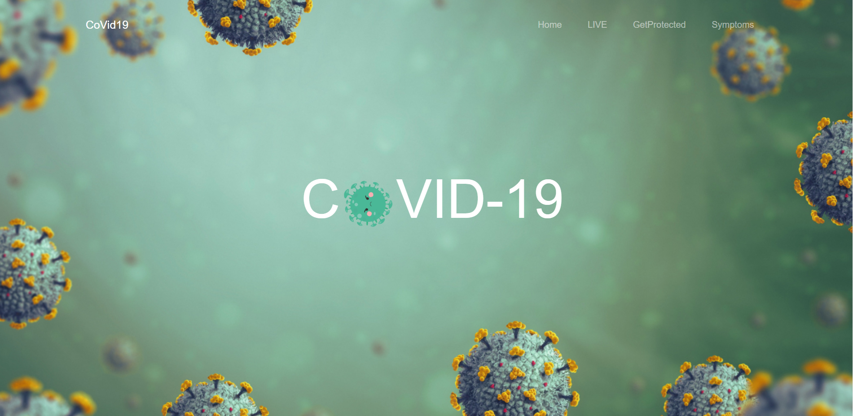
THE HOME PAGE

Slide 11
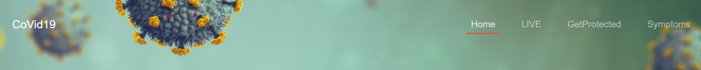
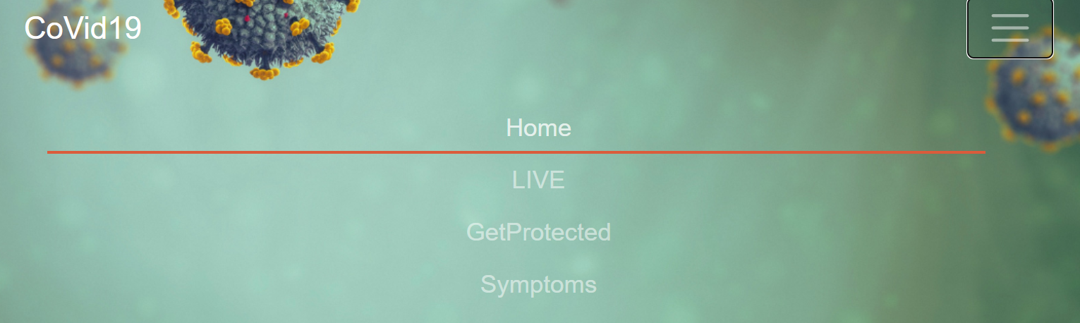
THE NAVBAR

Slide 12
NAVBAR
For making the navbar I have made use of the
“BOOTSTRAPS 4.0” predefined navbar classes
And for making the elements of the navbar I have made
Use of the <li> tag of the HTML.
Since the website is responsive for the mobile screen also
I have used the nav-bar collapse predefined class of the
“bootstraps 4.0” to make a collapsible menu

Slide 13
Navbar underline
To make the underline animation I have used some CSS properties and had used the PSEUDO class :Hover and Pseudo
Element : after
The :after selectors in CSS is used to add content before and after an element. The :hover is pseudo-class and :after are pseudo-elements. In CSS, pseudo-elements are written after pseudo-class.
Syntax:- a:hover::before {
// CSS Property
}
a:hover::after {
// CSS Property
}

Slide 14

THE Heading TEXT

Slide 15
THE HEADING TEXT
The heading text consists of an animation in which the circular image of the covid-19 .
Is under an animation of rotation the CSS property used make this happen is:-
.rotate {
animation: rotation 2s;
}
@keyframes rotation {
from {
transform: rotate(0deg);
}
to {
transform: rotate(359deg);
}
}

Slide 16
.linear{
animation-timing-function: linear;
}
.infinite{
animation-iteration-count: infinite;
}
So here to make the clear rotation I have used 3 class names for the same image tag named as:- rotate, linear and infinite.

Slide 17
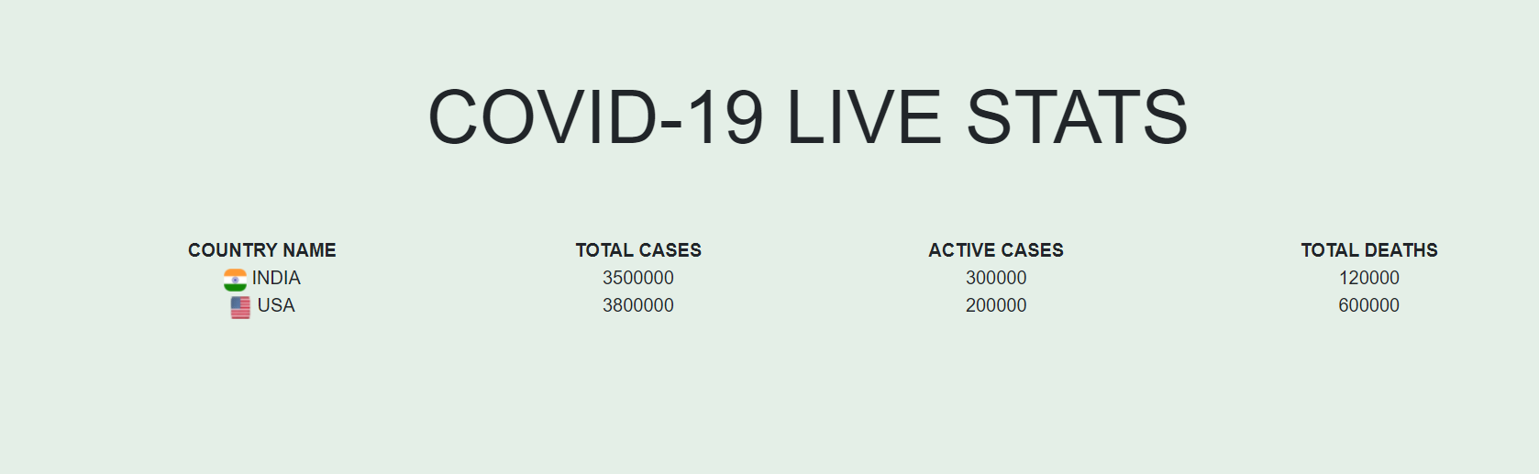
Live Stats Table

Slide 18
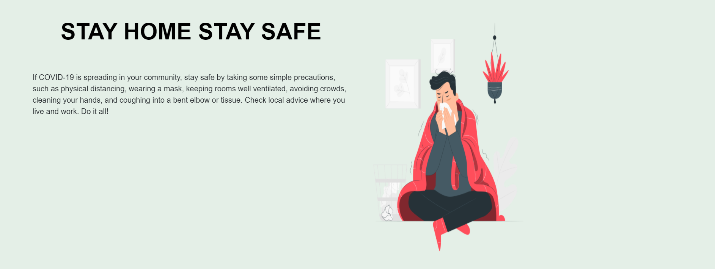
STAY HOME STAY PROTECTED

Slide 19
To make this I have used the bootstraps predefined class “ROWs”
Under which I have used the class “columns” which divide a row into 12 parts to make it half – half used the class col-lg-6
Where the class “lg” means large screen that is for the desktop screen.
To make it to the mobile view have used the class “sm” which means the small screen like mobile phones.

Slide 20
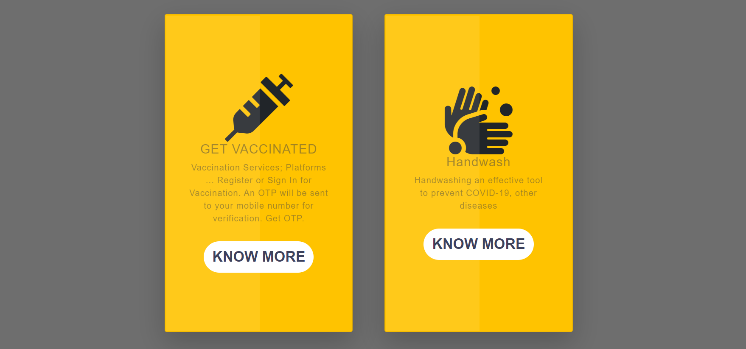
Get Protected

Slide 21
Get Protected
For making the cards I have used the bootstraps 4.0 class “cards”.
The each card has various information’s to make you protected from covid-19.
The card -1 has the basics details of vaccination and on clicking on the know more button you are redirected to the COWIN vaccine registration portal from where you can get yourself registered for the vaccination.
The second card has a basic information regarding how should you wash your hands regular basis so that you can get yourself more protected.
The third card has the general information related to how to wear mask.
The 4th card will let you to the live stats page from where you can get the live stats.

Slide 22
SYMBOLS AND LOGOS
The various symbols such as the symbol of the injection.
The handwash , mask ,graph.
All these symbols have been used from the “Font Awesome 6.0”.
Which has been linked in the project
To use this symbols I have used the <i> tag of the html
Under which the styling of the symbols have been done by the use of the class names as “fas”.

Slide 23
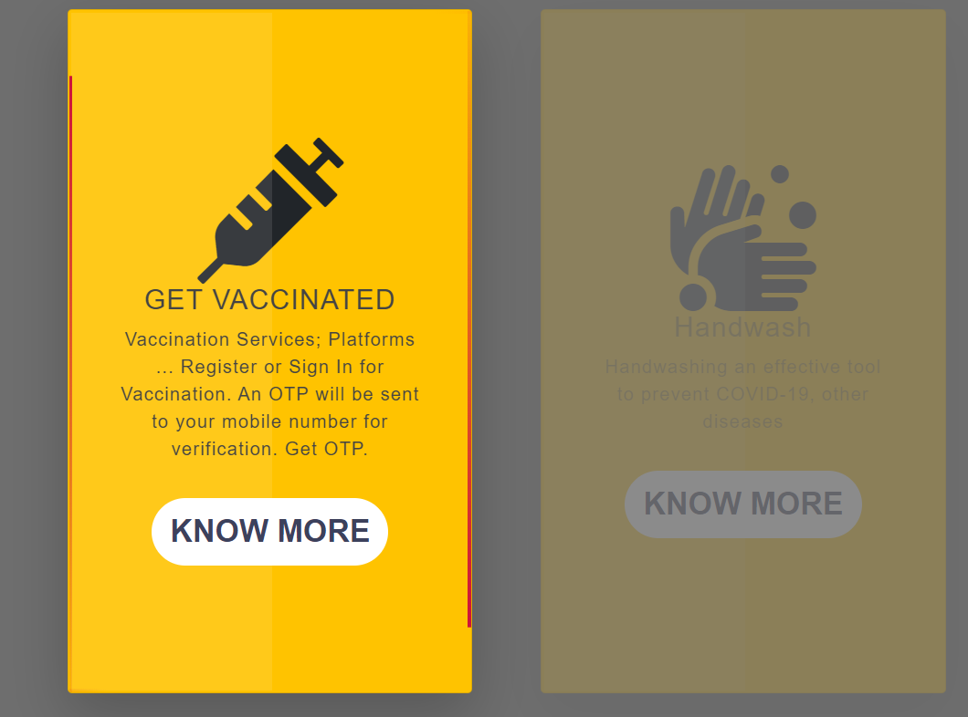
CARD ANIMATION

Slide 24
In the above screenshot we can see the animation that I have used in the card.
Which include the hover effect and the second is the line effect that is the line is covering each side of the card edges in an clockwise order.
In order to achieve this animation I have used the pseudo class hover and pseudo class element before.
To make the lines cover the edges of the card I have used the “@Keyframes” under which I have used various animate name 1,2,3,4 under which I have translate the line on the edges by using the property animation translate.

Slide 25
HTML PART OF THE CODE FOR CARDS
<div class="card col-lg-4">
<span></span>
<span></span>
<span></span>
<span></span>
<div class="content">

Slide 26
.container .card span:nth-child(1)
{
position: absolute;
top: 0;
left: 0;
width: 100%;
height: 3px;
background: linear-gradient(to right, transparent,#FF7600);
animation: animate1 2s linear infinite;
}
@keyframes animate1
{
0%{
transform: translateX(-100%);
}
100%{
transform: translateX(100%);
}
}

Slide 27
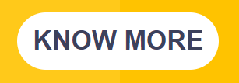
BUTTONS

Slide 28
BUTTONS
For the button animation I have used the pseudo class “hover” and pseudo class element “before”. To animate the button I have used the property “clip-path” and under which I have used the values for the polygon under which I have specified the various aspects of the polygon.

Slide 29
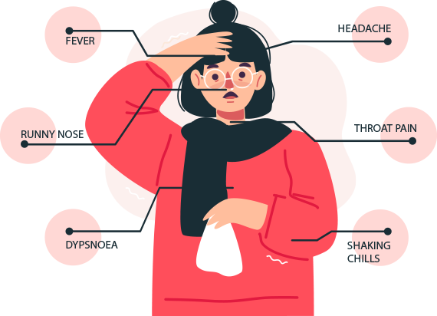
SYMPTOMS

Slide 30
For the symptoms section I have used an animated image
Which shows us the symptoms of the covid19.
And have designed the text and the image to occupy side
By side space with help of the class “rows ” and “col-lg-6”.
At last I Have used the tag <footer> to create the footer of the website.
And to add various symbols I have used the fontawesome.

Slide 31
conclusion
The conclusion of doing this project is that to let the people to know covid 19 live stats.
And to also inform that how they can protect them and
To get themselves registered for vaccination on the Co-Win app.

Slide 32
Bibliography
The complete web development bootcamp Udemy
MDN documentations.
Bootstraps documentations
Font awesome
Google Fonts
AppBewry

